Slide 1

“Reports of His Death were Sometimes Exaggerated: The Many Obituaries of Bertrand Russell”
Prof. Timothy Madigan
Professor and Chair of Philosophy
at
St. John Fisher College

Slide 2
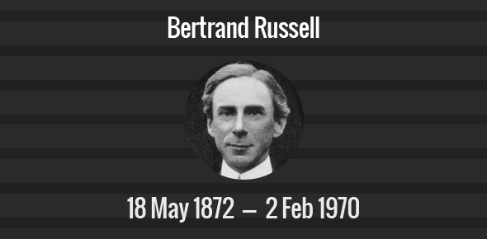

Slide 3
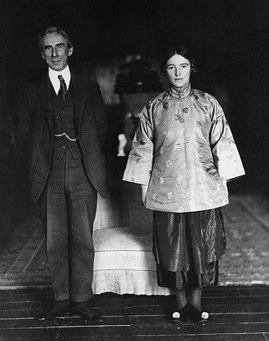
Bertrand and Dora in China 1921

Slide 4
“The Professor’s Love Story”
James Douglas, The Sunday Express
May 8, 1921
“Bertrand Russell was a complete and perfect eccentric of the kind colloquially known as a crank. There never was a crankier crank in this crank-ridden age. He was a learned professor of philosophy, an erudite mathematician, a pacifist, an anti-conscriptionist, a conscientious objector to everything. He was more like a discarnate and disembodied intellect than a human being.”

Slide 5
Frank Russell to the London Times
May 11, 1921
“Sir,—An unauthenticated report of the death of my brother Bertrand Russell published in many papers (though not in The Times) has caused much distress to his numerous friends. The Chinese Legation have most kindly made official inquiries at my request and now inform me that although it is true that he has been ill with pneumonia, he is now recovering. Perhaps you will be so good as to allow me to reassure those who have been anxious by making this announcement in your columns.”

Slide 6
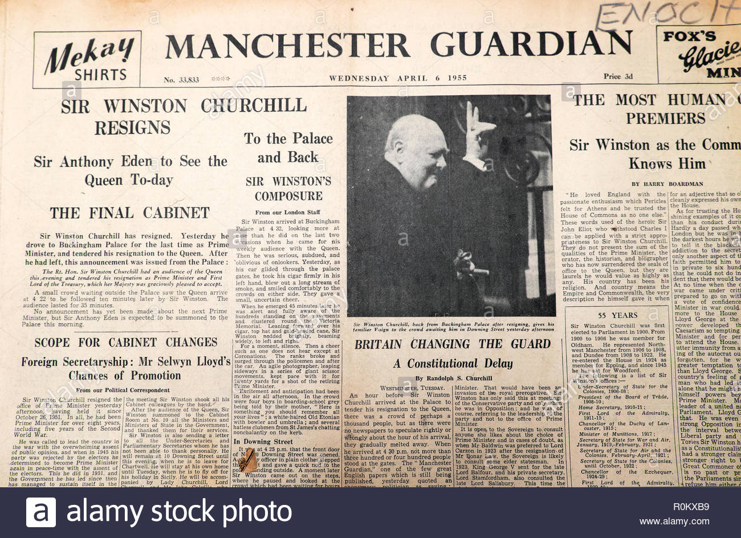
Russell to the Manchester Guardian
In 1955 Russell wrote to the Manchester Guardian that he had had “the pleasure of reading my own obituary notice in your forward-looking journal thirty-four years ago.”

Slide 7
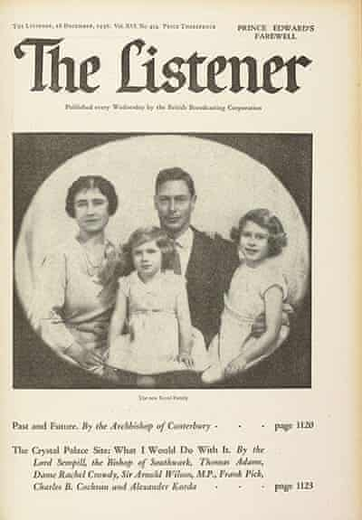

Slide 8
Esquire, Jan. 1, 1953
EDITOR’S NOTE: Throughout his adult life Bertrand Russell has tried to build his thought on principles of logical consistency. He has denounced patriotism as rapscallionry, politics as rapacity, religion as humbug, marriage as oppression. In the process he has made himself highly unpopular with the defenders of home and mother, and in England the strongest of these doughty swordsmen is the London Times.
This ironic self-obituary was written fifteen years ago, when Russell was 65, to be printed in the Times upon the occasion of his death on June 1, 1962. It needs a little updating, for Russell did not sit out the Second World War in silence— Hitler drove him from his pacifist convictions to support the Allied cause. Otherwise his enemies would probably accept his satiric self-judgments as they stand.
His friends could never do it. This obituary shows only one of his greatnesses: his love for laughing at himself. It omits his faith in man, and man’s reason, and man’s ability through his reason to build himself a happy, peaceful world.
It omits his enjoyment of his own life, and his work to make the lives of others—especially children—more enjoyable. And some mention of these works should be in any obituary.
Perhaps it will be. Russell at eighty is no softer than he was at 65, but even the defenders of our illogical society have come to see some merit in him. By the time he is ninety—and let everyone hope that he lives well beyond his self-predicted demise—the Times may find for him praises that he would never have given himself.

Slide 9
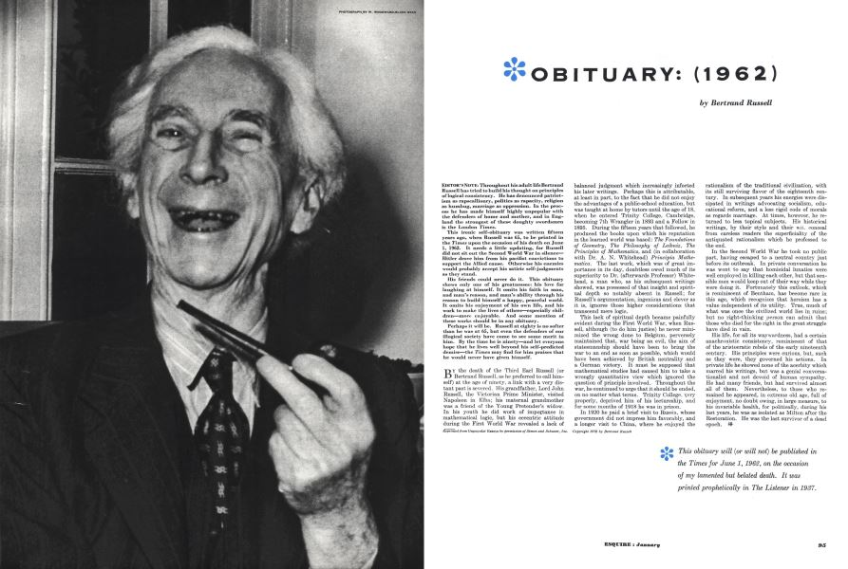

Slide 10
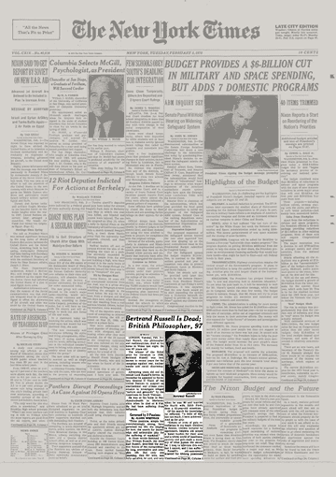

Slide 11
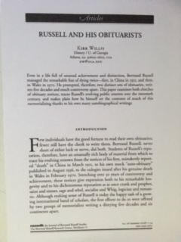
“Russell and His Obituarists”
Kirk Willis, Russell, Summer 2006

